Slide 1


SmartShelfX: AI-Based Inventory Forecast & Auto Restock
Presented by :
Chethan A

Slide 2





Addressing Critical Retail Challenges
Stockouts & Lost Sales
Overstock & Wasted Capital
Manual Inventory Errors
Missed opportunities due to unavailable products.
Prone to human mistakes and inaccuracies in data.
Capital tied up in unsold inventory, leading to losses.
Lack of Forecasting
Slow Vendor Coordination
Reactive decisions instead of proactive planning.
Inefficient communication with suppliers.

Slide 3
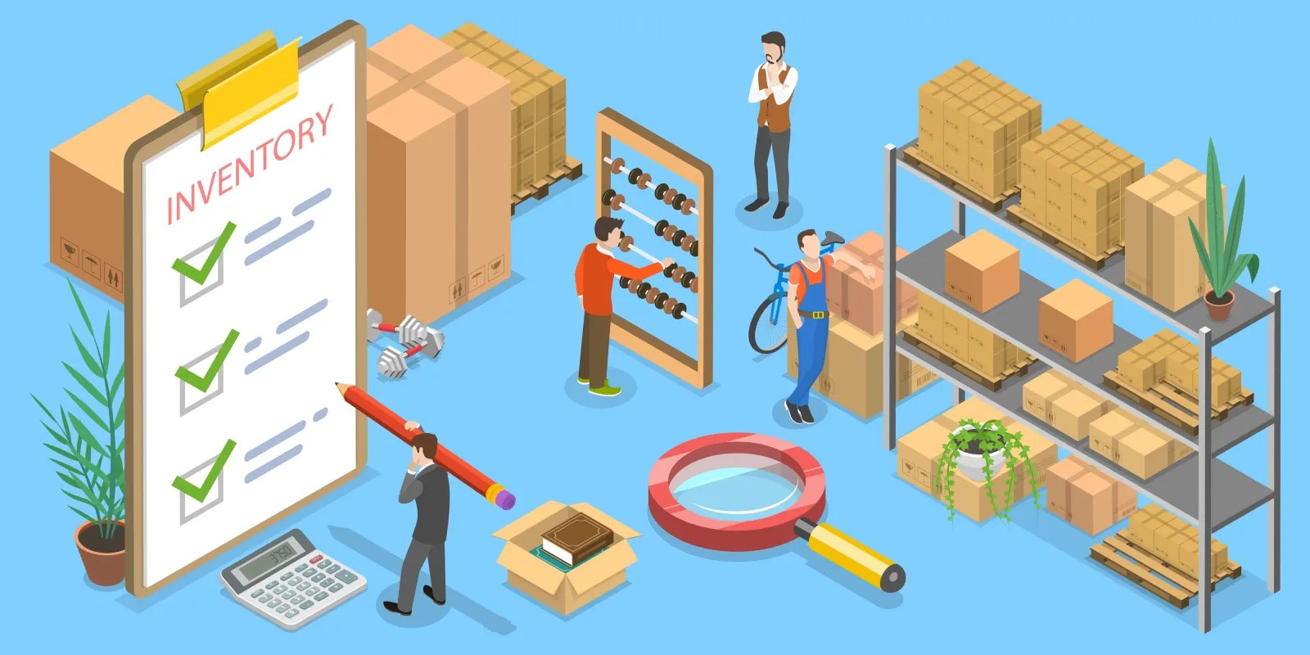





Introducing SmartShelfX: The Future of Inventory Management
AI-Powered Demand Forecasting
Predict future sales with high accuracy to optimise stock levels.
Automatic Restock Recommendations
Generate precise suggestions for replenishment, preventing stockouts.
Real-time Inventory Insights
Gain immediate visibility into stock levels and movements.
Vendor-Integrated Purchase Orders
Seamlessly communicate and manage orders with suppliers.
Performance Dashboards
Customised views for every role, ensuring relevant data access.

Slide 4


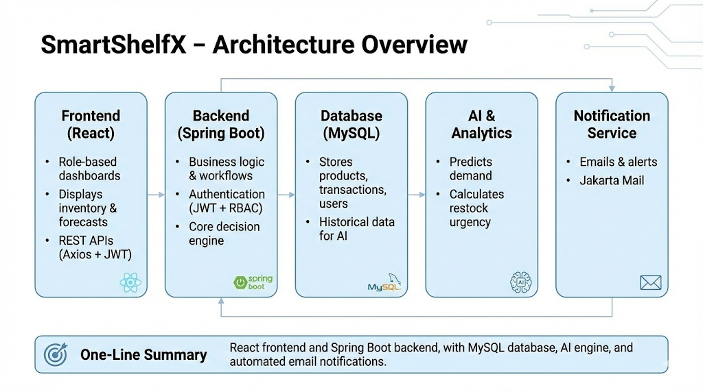



SmartShelfX System Architecture
Our robust architecture ensures a seamless, scalable, and intelligent inventory management experience.
React Frontend
Spring Boot Backend
User interface for seamless interaction.
Handles core logic and data operations.
MySQL Database
Secure storage for all inventory data.
AI Forecast Engine
Predicts demand and optimizes stock levels.
Email Service
Sends automated alerts and reports.

Slide 5
Core Features for Enhanced Operations
AI Restock Engine
Demand Forecasting
Leverages advanced algorithms to predict and suggest optimal stock levels, detecting urgency for critical items and providing editable recommendations based on demand.
Uses predictive analytics to anticipate future product needs with 7-day prediction charts, seasonality, and trend analysis for comprehensive insights.
Purchase Order Management
Inventory & Transaction Tracking
Streamlines supplier collaboration by allowing creation, approval, dispatch, and tracking of deliveries, enhanced with automated email alerts to vendors.
Provides a comprehensive overview of all products and movements through a detailed product catalog, stock IN/OUT logs, and color-coded stock levels for traceability and quick identification.

Slide 6





Role-Based Dashboards for Tailored Insights
Admin Dashboard
Manager Dashboard
Vendor Dashboard
Full system controls and user management
Operational KPIs and team performance
Inventory orders and fulfillment status
SmartShelfX provides customised interfaces, ensuring each user has access to the most relevant information and controls for their role.

Slide 7





Key Business Benefits
Improved Inventory Accuracy
Reduced Carrying Costs
Minimized stock discrepancies, leading to fewer stockouts and overstocks.
Optimized inventory levels decrease storage expenses and minimize waste from obsolescence.
Accelerated Order Fulfillment
Enhanced Customer Satisfaction
Streamlined processes and automated tasks enhance the entire order-to-delivery cycle.
Improved product availability and fewer fulfillment errors boost customer loyalty and positive feedback.
SmartShelfX has demonstrably improved operational efficiency and decision-making for our retail partners.

Slide 8
Conclusion
SmartShelfX revolutionises retail inventory management through intelligent automation, precise forecasting, and seamless vendor collaboration. It empowers businesses to minimise stockouts, reduce overstock, and enhance overall operational efficiency.
Strategic Competitive Advantage
Continuous Innovation
Gain unparalleled visibility and control over stock, positioning your business for sustained success and a strong competitive edge.
Our unwavering commitment to integrating advanced analytics and AI ensures continuous enhancements, future-proofing your operations and delivering tangible value.

Slide 9
Thank You

